Slide 1

2023 PK Guide

Slide 2
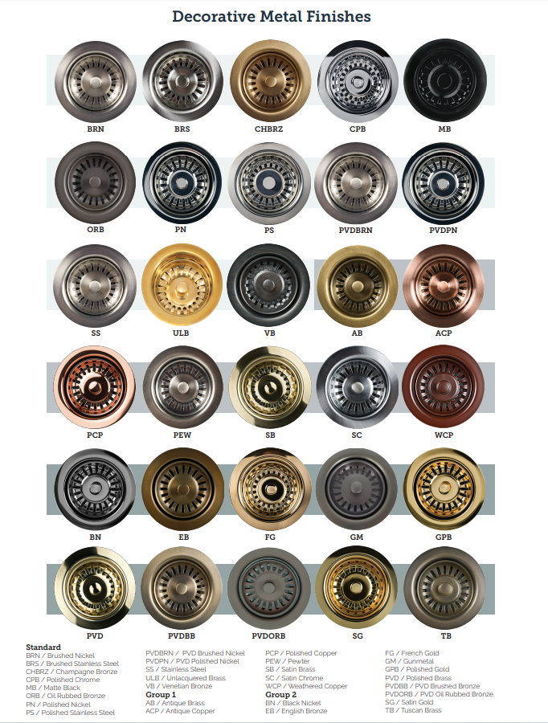
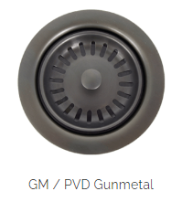
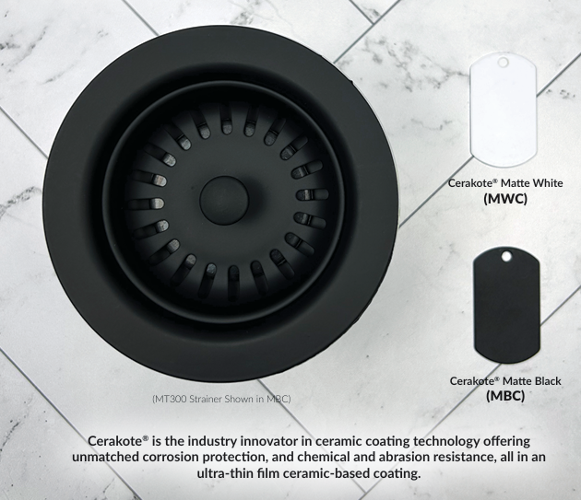
Decorative Finish Options
New for 2024/2025

Slide 3

Glass Rinser
Wider footprint to accommodate Wide Mouth tumblers (Yeti/Stanley/Etc).
Wider paddles to help prevent cracking on fine stemware.
Removable paddle and rubber inserts for ease of cleaning.
Can be ordered in all finishes.

Slide 4

Single Lever Hot/Cold Faucet
Contemporary design for clean look.
Pull forward for cold, center stop, push button back for instant hot water. Unique safety push button feature to prevent burns.
Lever/Handle is not spring loaded and does not pop into place when released.

Slide 5
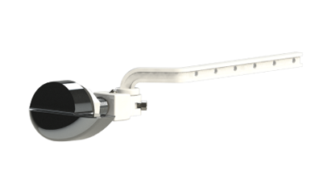
Universal Toilet Tank Lever
MT969U
Universal design to fit most all toilet tanks.
For use with most front, side, and angled style toilet tanks with chain style flush valves.
Available in a variety of finishes to match every fixture in your bathroom.

Slide 6
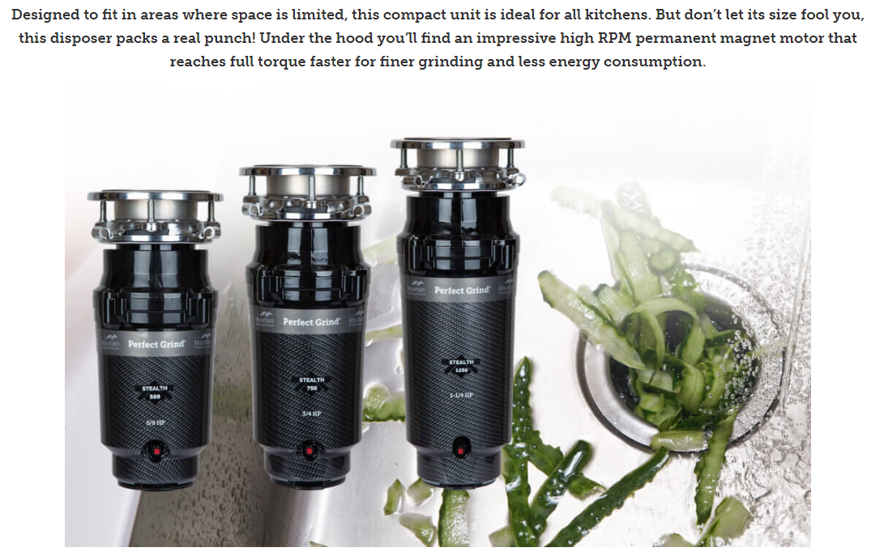
STEALTH Disposers

Slide 7
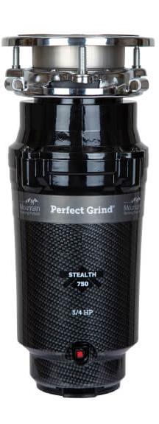
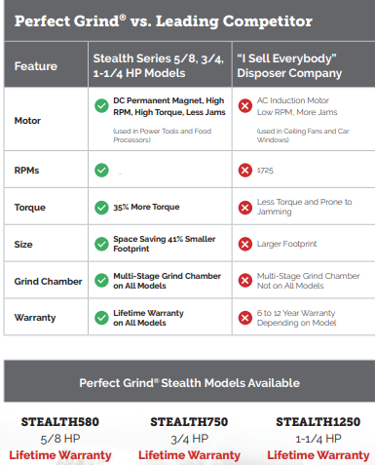
STEALTH Disposers
4000

Slide 8
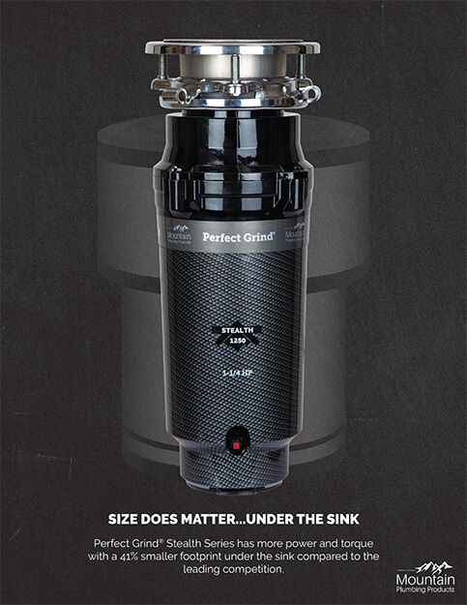
STEALTH Disposers
Size Does Matter…Under The Sink
The Perfect Grind® STEALTH Series has more power and torque with a 41% smaller footprint under the sink compared to the leading competition. Each model only measures 5-5/16″ wide with a height between 12-1/8″ and 14-5/8″.

Slide 9
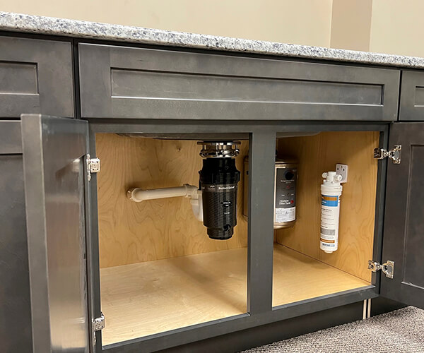
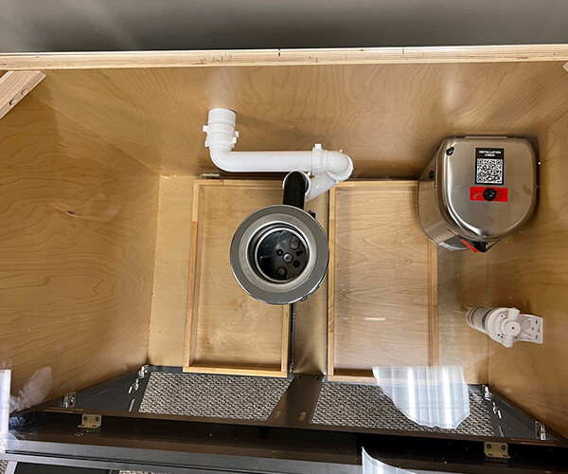
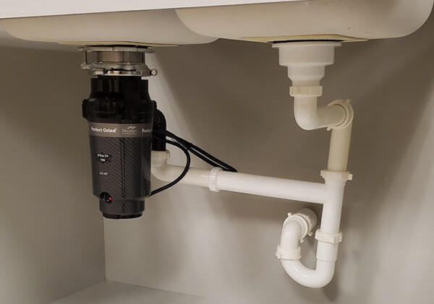
STEALTHTRAP
By orienting the disposer discharge tube toward the back of the cabinet and using a STEALTHTRAP, customers can save vital storage space under the kitchen sink.
STEALTHTRAP is included with every STEALTH disposer; includes parts for single and double bowl.

Slide 10
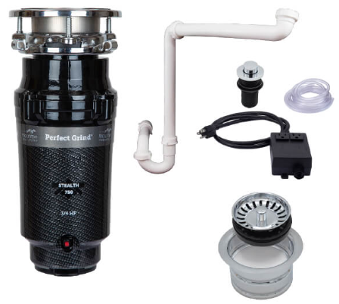
Complete Kitchen Sink Packages
There are 8 total packages available and you can chose from 12 of our most popular finishes.
And the best part…each package represents a 10% savings compared to purchasing items separately
Packages include
STEALTH750 (3/4 hp) Disposer
Air Switch
STEALTHTRAP
Disposer Trim
Sink Strainer (if double bowl)

Slide 11
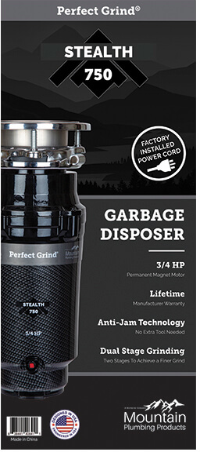
STEALTH
All STEALTH models have LIFETIME Warranty!
⅝ hp – 3400 RPM
¾ hp – 3600 RPM
1-¼ hp – 4000 RPM
Not sold in Big Box retail stores

Slide 12
Speed and Performance
Mountain Perfect Grind disposers are 30% faster (2800 to 4000 RPMs) vs the ISE AC motor (1725 RPM).
Motor Speed + Design of Chamber = FASTER GRINDING
This means the consumer finished the job much faster and spends less time over the sink.
ProSelect and STEALTH are all septic system safe.

Slide 13
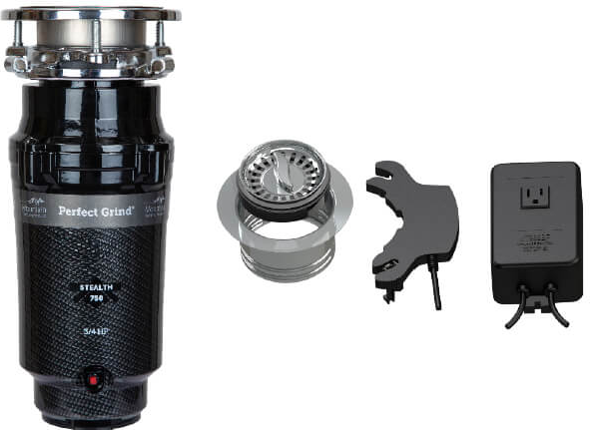
Batch Feed
MT777BF/***
Converts a continuous feed disposer to batch feed with no rewiring needed
Dual Functionality: Can be used as a normal strainer basket when disposer is not in use
Fully plated stainless steel strainer basket and sink flange
STEALTH 750 Disposer

Slide 14
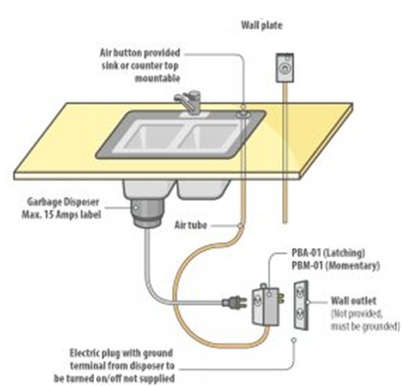
Kitchen Sink Accessories
Air Switches
Safety – Eliminate the risk of electrical shock
Perfect for island sink installations

Slide 15
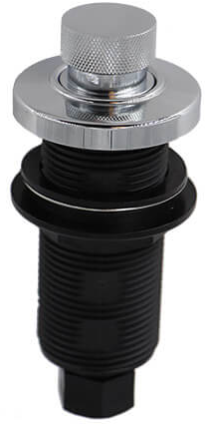
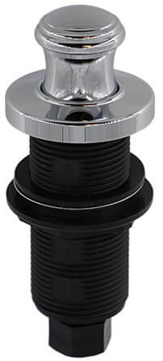
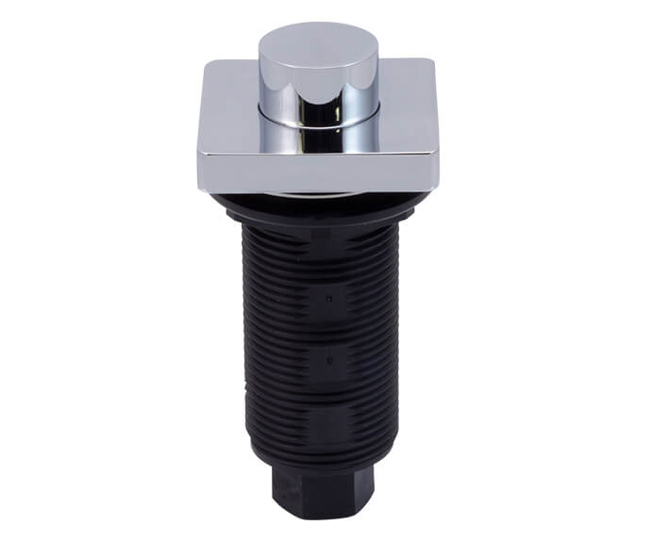
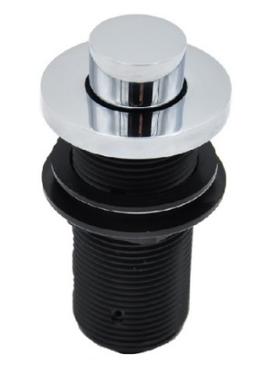
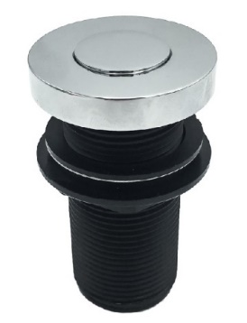
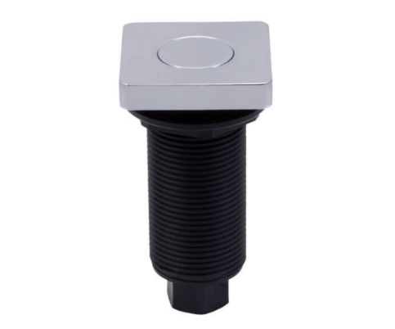
Kitchen Sink Accessories
Deluxe Air Switches
Solid Brass Button & Flange
Longer Threaded Shank
Better Price Point
MT964K
MT964T
MT962R
NOTE: Some manufacturers do not offer air switches: i.e. Kohler, DXV, Grohe, Hansgrohe,
MT957
MT957R
MT962

Slide 16

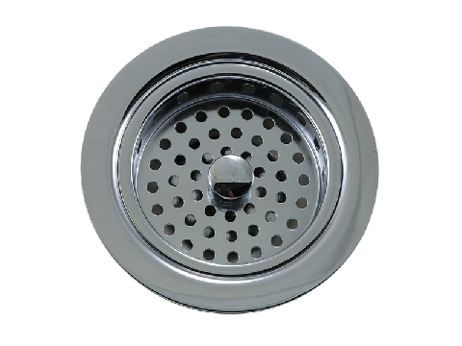
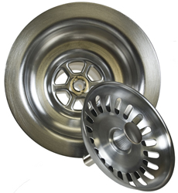
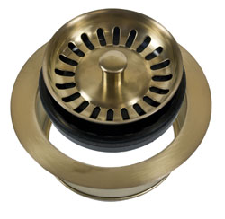
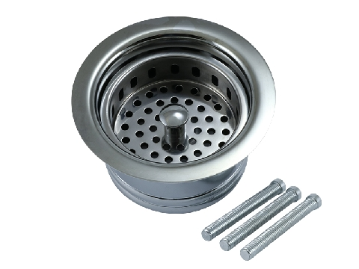
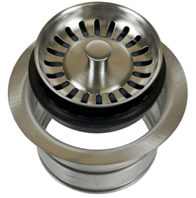
Kitchen Sink Accessories
Sink Strainers & Matching Disposer Flanges
Traditional
Duo Strainer
Classic
Sink
Sink
MT8799
MT300
MT200EV
Disposer
Extended flange
3 bolts included to used when installing on thinner sinks
MT7799EV
Extended flange
Disposer
MT202
Disposer

Slide 17

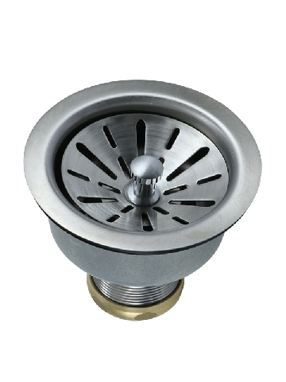
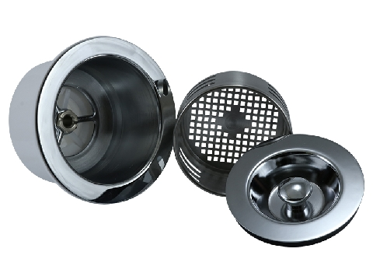
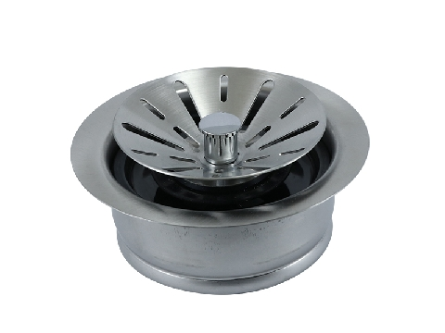
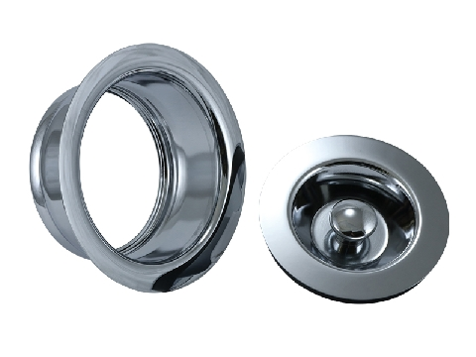
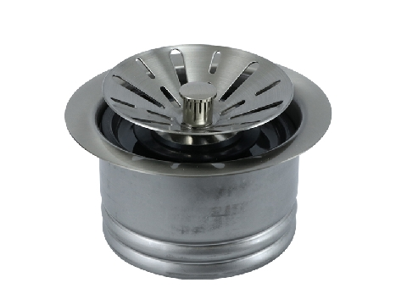
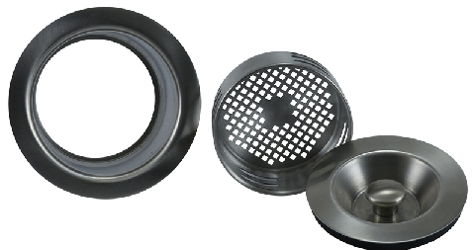
Kitchen Sink Accessories
Sink Strainers & Matching Disposer Flanges
Contemporary
3-in-1
MT310
MT115
Sink
Sink
MT120EV
Disposer
Removable basket NOT included
MT210EV
Disposer
Extended flange
3 bolts included to used when installing on thinner sinks
Includes removable basket
Extended flange
MT212EV
Disposer
MT130
Disposer

Slide 18
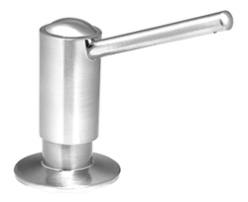

Kitchen Sink Accessories
Soap / Lotion Dispensers
Larger 16 oz reservoir bottle vs competitors 12 oz
All units easily refill from above the countertop
Lifetime warranty on all pumps

Slide 19


Water Appliances
Little Gourmet Premium Hot Water System
Reverse Osmosis Compatible
190°+ Instantly
1300w Power
Energy Efficient – Uses less energy than a 40w light bulb
5/8 Gallon Tank Size
3 Year Warranty
MT641-3

Slide 20

Instant Hot Water
Little Gourmet® Premium Hot Water Tank / Dispenser

Slide 21
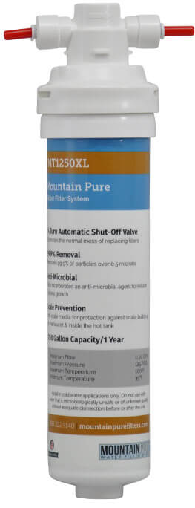
Water Appliances
*Now a 4 Year Warranty
Extra year of warranty added when any Mountain Pure Water Filtration System is used with the heating tank
+

Slide 22
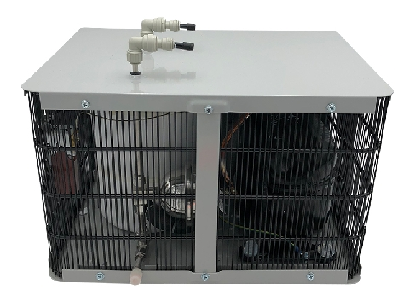

Water Appliances
Mountain Chill Water Chiller
39° to 50° Water Instantly
1.5 Gallons per Hour
1/2 Gallon Tank Size
3 Year Warranty
MT670-2

Slide 23

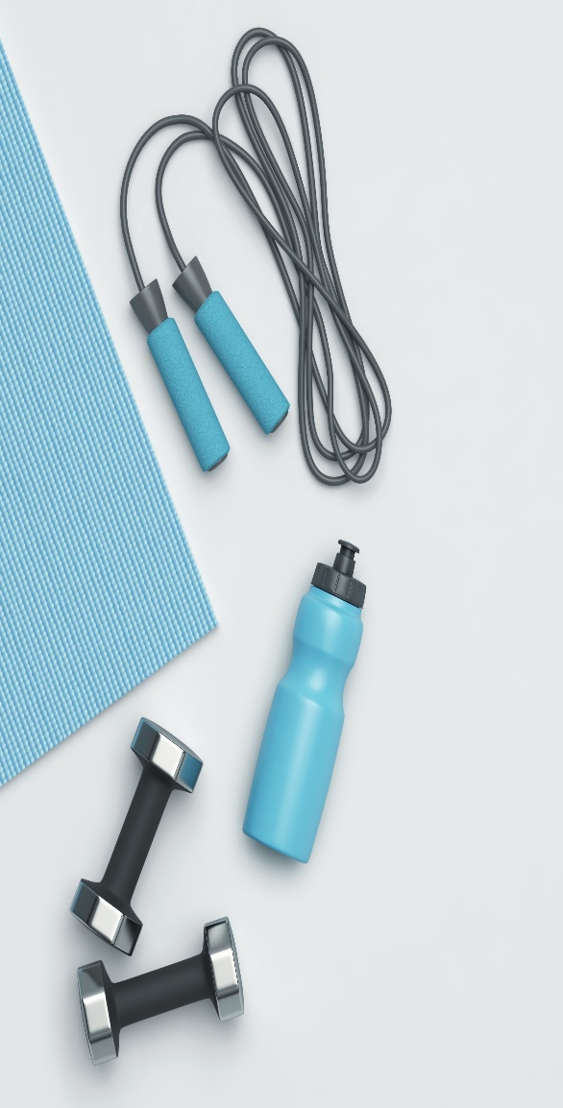
Water Appliances
Mountain Pure Water Filtration
The case for the need of water filtration has been made. Homeowners regularly drink bottled water or ‘filtered’ water from the refrigerator which can be unreliable to filter out impurities.

Slide 24

Water Appliances
LEAD
Homes built prior to 1986 may have 20% or more lead in their plumbing system
Lead can be found in newer homes as well…until June 2014, the legal limit for “lead-free” pipes was up to 8%
Source: EPA Website
Notes:
EPA website

Slide 25
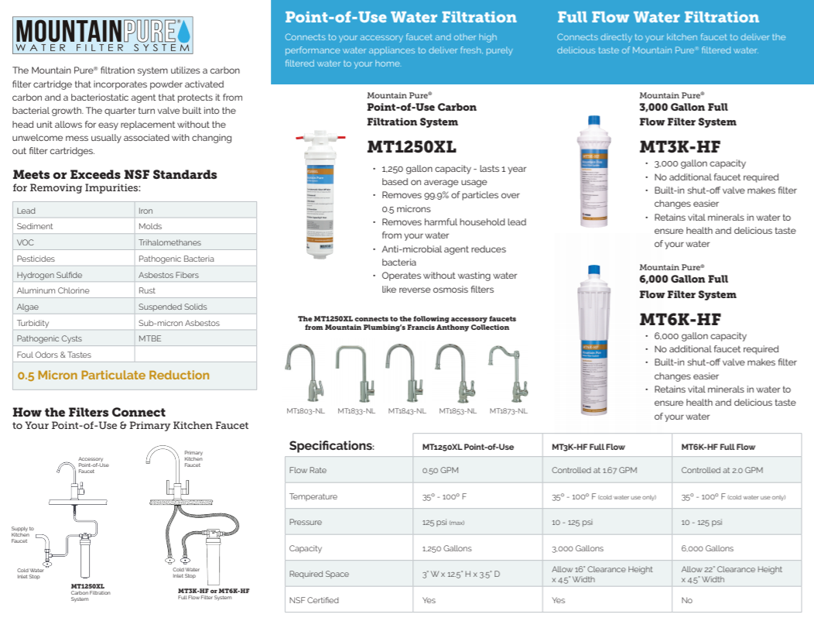
Water Appliances
39° to 50° Water Instantly
1.5 Gallons per Hour
1/2 Gallon Tank Size
3 Year Warranty

Slide 26
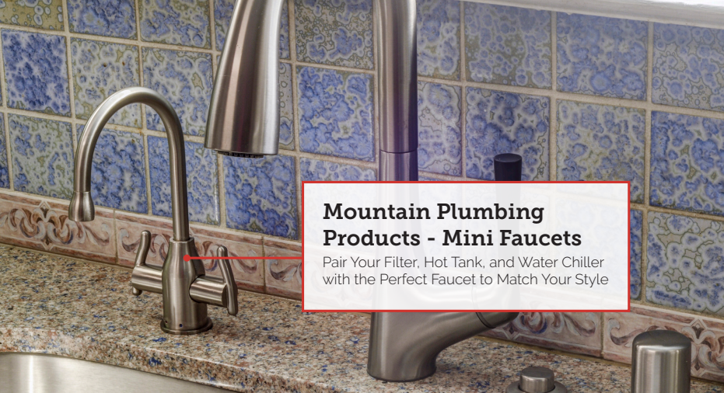
Water Appliances

Slide 27

Point of Use Faucets

Slide 28

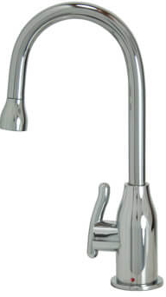
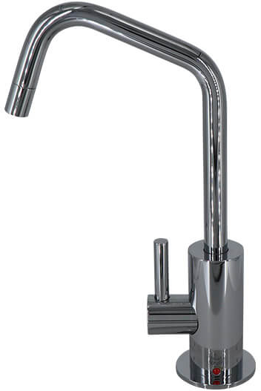
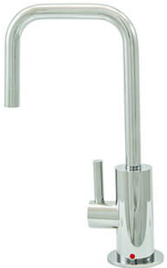
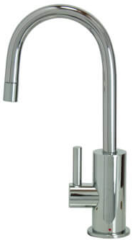
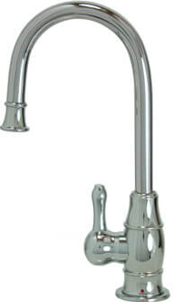
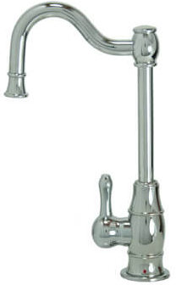
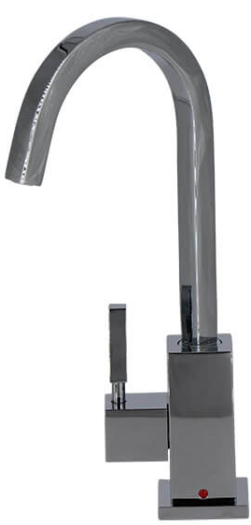
Water Appliances
The Francis Anthony Collection of Point of Use and Instant Hot Faucets are among the smallest available. Utilizing a mini cartridge designed in Europe, the Francis Anthony faucets are not just shorter, but maintain their proportions throughout the entire faucet
MT1800
MT1820
MT1830
MT1840
MT1850
MT1870
MT1880

Slide 29
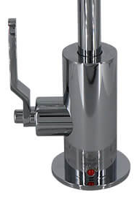
Industrial Lever Handle
Available in the following faucet series:
MT1820
MT1830
MT1840

Slide 30
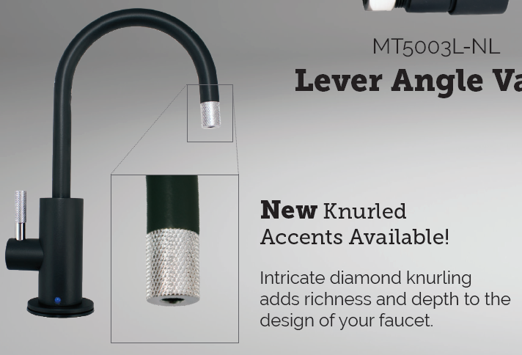
Knurling
Knurled Accents
Intricate diamond knurling adds richness and depth to the design of your faucet. Knurling accents are becoming more common in modern classic environments and urban industrial spaces.

Slide 31
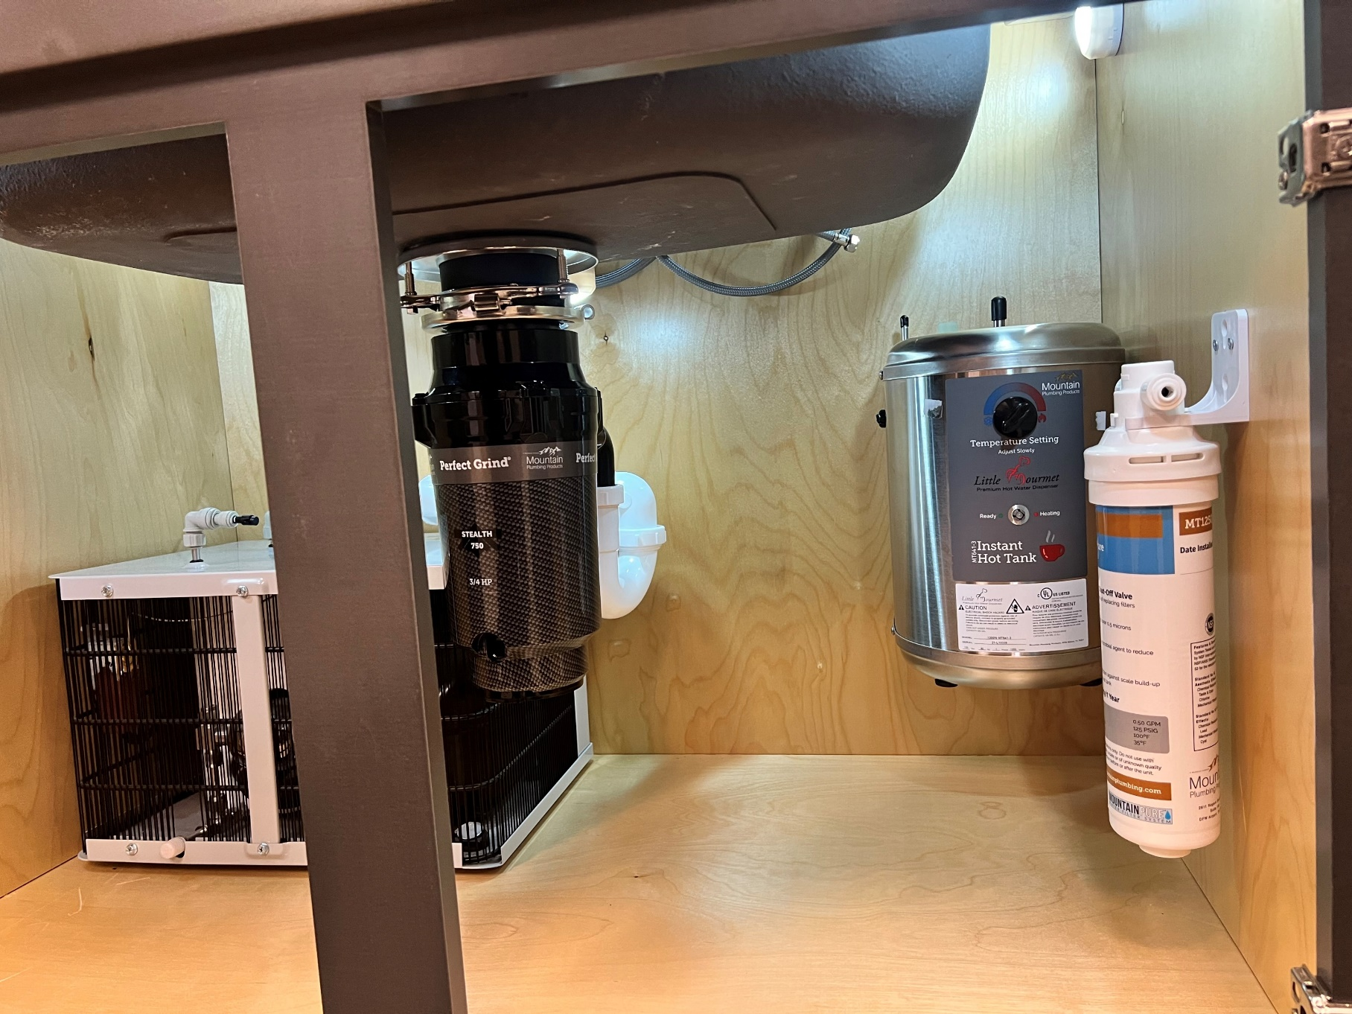
Under Cabinet Peek

Slide 32
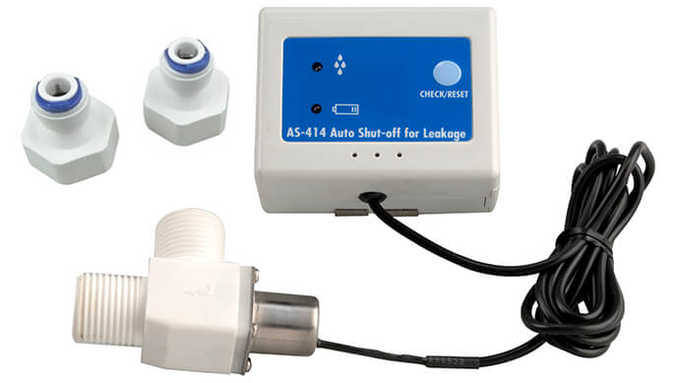
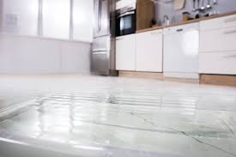
Water Appliances
Safety Valve - Leak Detector
Automatically shuts off once water is detected
Audio alarm when leak occurs
Operates on 9V battery
Quick connect 1/4″ adaptor included for easy installations
Use with Mountain Plumbing Little Gourmet hot tank and/or Mountain Pure filtration unit

Slide 33

Duet Finishes
Mountain Plumbing’s Duet Finish Collection highlights elements of your kitchen and bath design to give a truly balanced and unique look. This product has a more modern style, yet can match with many designs.
Duet Finish Combinations
Combining the modern Matte Black finish with four complimentary colors, specific details of each part stand out. These products give a truly balanced look and a touch of flair to an often forgotten element of designing a kitchen or bath.

Slide 34



Re-Vive Collection – Rain Heads
3 Styles
Round (6”,8”,10”,12, 16”)
Square (6”,8”,10”,12”, 16”)
Traditional (9”)
Ultra Slim Design, Less Than 3mm
Stainless Steel
Seamless Construction
Clog Free nozzles
1.6 GPM Standard w/ 2.5 GPM Restrictor Included
*Finishes: CPB, BRN, PN, ORB, MB, VB

Slide 35

Re-Vive Collection – New for 2023
8″ Multifunction Shower Head
ABS Plastic Construction
1/2″ Swivel Ball Joint for Angle Adjustment
1.6 GPM (2.5 GPM Restrictor Also Included)
6 Functions:
Pellet
Trickle
Waterfall
Full Spray
Water Column
Full Spray + Water Column
Only available in: BRN, CPB, MB

Slide 36

Re-Vive Collection – New for 2023
5″ Multifunction Hand Shower
ABS Plastic Construction
Interior Lining Prevents Scalding
1.6 or 2.5 GPM Flow Restrictors Included
9 Functions:
Power Wash
Mist
Pellet
Trickle
Massage
Waterfall
Full Spray
Pellet + Mist
Full Spray + Mist
Only available in: BRN, CPB, MB

Slide 37











Re-Vive Collection – Accessories
Arms
Hand Showers

Slide 38














Re-Vive Collection – Accessories
Slide Rails
Hand Shower Holders
With Integral Waterway
Slide Rail Only
Hand Shower Hose
MT8SRW
MT9SRW
MT9SR
MT8SR

Slide 39


Re-Vive Collection – Rain Rail Plus
Rain Rail Plus
Perfect for retrofit remodel
No need to break into wall
Ties into existing shower arm outlet and anchors over tile
cUPC approved
Components sold individually
i.e. shower head, hose, hand shower

Slide 40


Re-Vive Collection – Rain Rail Plus
Introducing new size – 18”
MTRRP-18/***
2-way divertor for California
Includes angled hose connector
25”
Or
18”

Slide 41





Select Series Shower Drains
Trim Options
Drain Neck Assembly
Plastic Construction
‘Vanishing’ Thin Edge Design
Includes Hair Catcher & Debris Cover
MT607
MT606
4” Square
3/16” Thick 304 Stainless Steel
Includes Grid Removal Tool
Schluter Adaptor
MT608
Plastic Construction
Allows For Installation into Fabric Water Proofing Systems; i.e. Schluter-KERDI
Tile-in
3-1/2” Square Grid
Plastic Construction
Includes Grid Removal Tool
MT603A
MT609

Slide 42


Bathroom Accessories
Valves
Selecting the Correct Stop
¼ Turn Ball or ¼ Turn Ceramic Cartridge
Angle or Straight
(Inlet) - Compression or IPS or Sweat
X
3/8” O.D. Compression (Outlet)

Slide 43

New Valve Design
Lever Handle Ball Valve
MT521-NL
Only available in Angle Compression
Mini Lever Handle with 1/4 Turn Ball Valve
1/2″ Compression (5/8″ O.D.) Inlet
3/8″ O.D. Compression Outlet
Lead Free

Slide 44






Bathroom Accessories
Lav Drains
Traps
With or Without Overflow
20 Hole Grid, Clicker, Lift & Turn, Finger Touch, Stationary Dome, Flat Dome Euro, Tear Drop & Square Designs
P-Trap
Bottle Trap
MT2000-2 Has Cleanout

Slide 45








Bathroom Accessories
Toilet Tank Levers
  Toto
  Kohler
  American Standard
  Icera
  Axent
  *Compatible with most styles within these brands.

Slide 46


Bath Waste & Overflow
Immerse Feature

Slide 47



Bath Waste & Overflow
DoubleFlex Feature
Bath waste installations just became faster and easier. The DoubleFlex is designed to handle misalignment problems.
The SECRET...patented swivel joints at the overflow head and at the sanitary tee. Available in PVC and ABS.
Problem/Scenario 1
Problem/Scenario 2

Slide 48


BDEXP Drains
Freestanding Tub Exposed Bath Waste & Overflows
BDEXP
5 Different Models
Bottom Outlet BDEXP1
Direct Outlet BDEXP2
Detached BDEXP3
Bottom Outlet Extended BDEXP1-VA
Direct Outlet Extended BDEXP2-VA
  Extended models will fit Victoria & Albert tubs
Available in CPB, BRN, PN, MB, CHBRZ
BDEXP1
BDEXP2
BDEXP3
BDEXP1-VA
BDEXP2-VA

Slide 49

Tub Docking Station
The “Old Way”
Need to tilt the big, heavy, expensive tub on its side.
Must connect the drain through the top of the tub to the brass tailpiece from the underside.
Requires lifting of the entire tub and precisely dropping into place.
Higher risk of damage when moving tub multiple times while installing.
Don’t know if there is a leak until after installation.
Would have to remove the entire tub to replace the drain once installed.
Near impossible to snake the tub should there be a clog in the line.
Tub drain NOT included – have to find one that matches tailpiece and fixtures.

Slide 50

Tub Docking Station
The “Tub Docking Station Way”
No tilting of the tub on its side, it remains upright.
Rough-in flange and tailpiece are mounted to the floor and not to the tub itself.
Simply slide the tub into place over the drain – No lifting or lowering required.
Drain is removable after installation without needing to uninstall the tub.
Plug top is removable to allow easy access to snake the line.
EZ-Click™ Tub Drain IS included and available in multiple finishes to match fixtures.

Slide 51

Tub Docking Station

